Slide 1
Digital Portfolio
NAME : S.KEERTHANA
REG NO AND NMID : 24131211802522034,
ASANM121ANM12124214035
DEPARTMENT : B.SC COMPUTER SCIENCE
COLLEGE: COLLEGE/ UNIVERSITY:
IMMACULATE COLLEGE FOR WOMEN /ANNAMALAI UNIVERSITY

Slide 2
WEBDEVELOPMENT:
FORM CREATION
TABLE CREATION

Slide 3
AGENDA:
Problem Statement
Project Overview
End Users
Tools and Technologies
Portfolio design and Layout
Features and Functionality
Results and Screenshots
Conclusion
Github Link

Slide 4
PROBLEM STATEMENT:
FOR FORM CREATION
Design and develop a web-based registration form using HTML, CSS, and JavaScript that collects essential user information and provides real-time validation.
FOR TABLE CREATION
Design and develop a student record table using HTML, CSS, and JavaScript that displays and organizes student information in a clear and interactive manner.

Slide 5
PROJECT OVERVIEW:
Developed a digital portfolio website to showcase academic, technical, and personal projects.
Provides an easy-to-navigate, responsive interface.
Aims to help in career opportunities, internships, and collaborations.

Slide 6
END USERS?
STUDENTS / APPLICANTS
They use the registration form to enter their personal and academic details for admission.
They interact with the form fields, validations, and submit their information.
COLLEGE / UNIVERSITY ADMINISTRATION
They use the student records table to view, sort, and search student data.
Helps in managing admission records efficiently.
TEACHERS / STAFF
They can check student details, marks, and grades from the table.
Useful for maintaining departmental records.
SYSTEM DEVELOPERS / DESIGNERS (SECONDARY END USERS)
They test and enhance the form and table functionalities.
Use the project as a learning/demo tool for frontend web development.

Slide 7
TOOLS AND TECHNIQUES:
Frontend:
HTML, CSS, JavaScript, React
Backend:
Node.js / Django / Flask (choose as per your project)
Database:
MySQL / MongoDB
Design Tools:
Figma / Canva
Version Control:
Git & GitHub
>
>

Slide 8
POTFOLIO DESIGN AND LAYOUT
Cover Page – Project Title, Your Name/Roll No, College/Dept, Year.
Index – List of sections with page numbers.
Introduction – Brief on forms & tables in web development.
Problem Statement & Objectives – Why the project is needed and its goals.
Tools & Techniques – HTML, CSS, JavaScript, Browser, Editor.
System Design – Layout diagrams/wireframes of form and table.
Implementation – Code snippets + screenshots of output.
Results – Successful form validation & interactive table.
Conclusion – Key learnings & outcomes.
Future Scope – Database integration, login, export features.
References – Books, websites, or tutorials used.

Slide 9
FEATURES AND FUNCTIONALITY
Form Creation
User-friendly form with labeled fields (Name, Email, Phone, DOB, etc.).
Validation using HTML5 and JavaScript (required fields, email format, number limits).
Table Creation
Structured data display using rows and columns.
Styled layout with CSS (borders, alternating row colors, hover effects).
Dynamic update (new entries can be added from form into table).

Slide 10
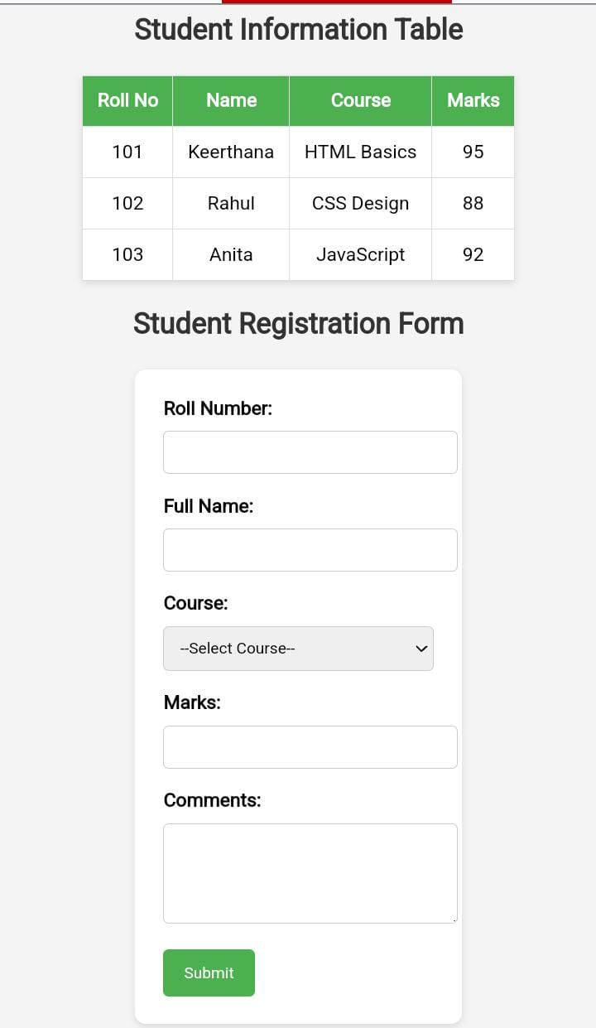
RESULT AND OUTPUT

Slide 11
CONCLUSION
Digital portfolio provides a modern alternative to traditional resumes.
Enhances professional visibility and career opportunities.
Acts as a dynamic platform that grows with personal and professional achievements.

Slide 12
THANK YOU...

